Slide 1
Chapter 2: Chemistry

Slide 2
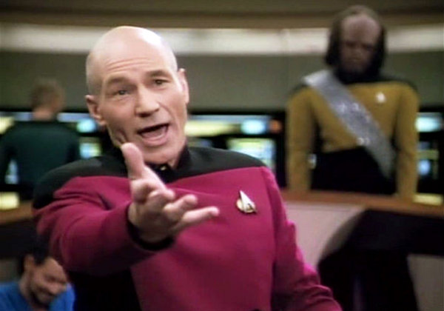
But this is BIOLOGY!!

Slide 3
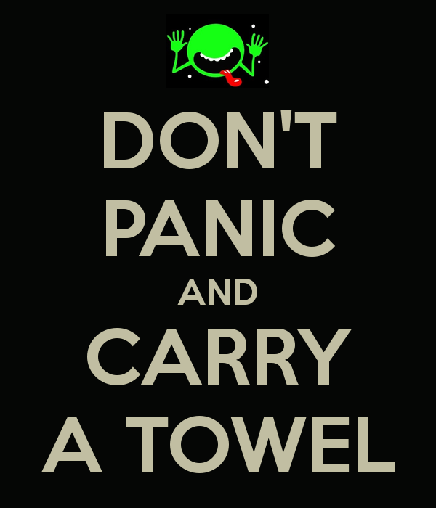

Don’t Panic

Slide 4
Basic Principles
Chemistry is the science of the structure and interactions of matter.
Matter is anything that occupies space and has mass.
  Mass is the amount of matter a substance contains
  weight is the force of gravity acting on a mass.

Slide 5
HOW MATTER IS ORGANIZED
Chemical Elements
  All forms of matter are composed of chemical elements which are substances that cannot be split into simpler substances by ordinary chemical means.
  Elements have abbreviations called chemical symbols.
    Oxygen (O), carbon (C), hydrogen (H), and nitrogen (N) make up 96% of body weight.
    These elements, together with calcium (Ca) and phosphorus (P) make up 98.5% of total body weight.
  Trace elements are present in tiny amounts
    copper, tin, selenium & zinc

Slide 6
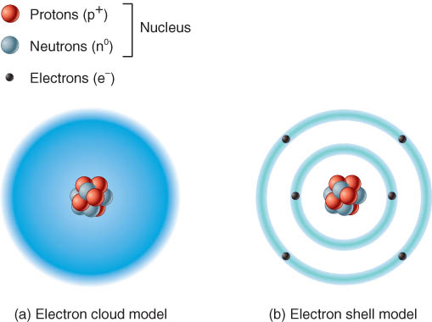
Structure of Atoms
Atoms are the smallest units of matter that retain the properties of an element
3 types of subatomic particles
  protons, neutrons and electrons
Nucleus: protons (p+) & neutrons (neutral charge)
Electrons (e-) surround the nucleus as a cloud (electron shells are designated regions of the cloud)

Slide 7
Ions, Molecules, & Compounds
Ions
  an atom that gave up or gained an electron
  written with its chemical symbol and (+) or (-)
Molecule
  atoms share electrons
  written as molecular formula showing the number of atoms of each element (H₂O)

Slide 8
Chemical Bonds
What are they?
Types
  Ionic
  Covalent
  Polar covalent
  Hydrogen
Water
pH
Chemical reactions

Slide 9
Chemical Bonds
The atoms of a molecule are held together by forces of attraction called chemical bonds.
The likelihood that an atom will form a chemical bond with another atom depends on the number of electrons in its outermost shell, also called the valence shell.

Slide 10
Ionic Bonds
When an atom loses or gains a valence electron, ions are formed
Positively and negatively charged ions are attracted to one another.
Cations are positively charged ions that have given up one or more electrons (they are electron donors).
Anions are negatively charged ions that have picked up one or more electrons that another atom has lost (they are electron acceptors).

Slide 11
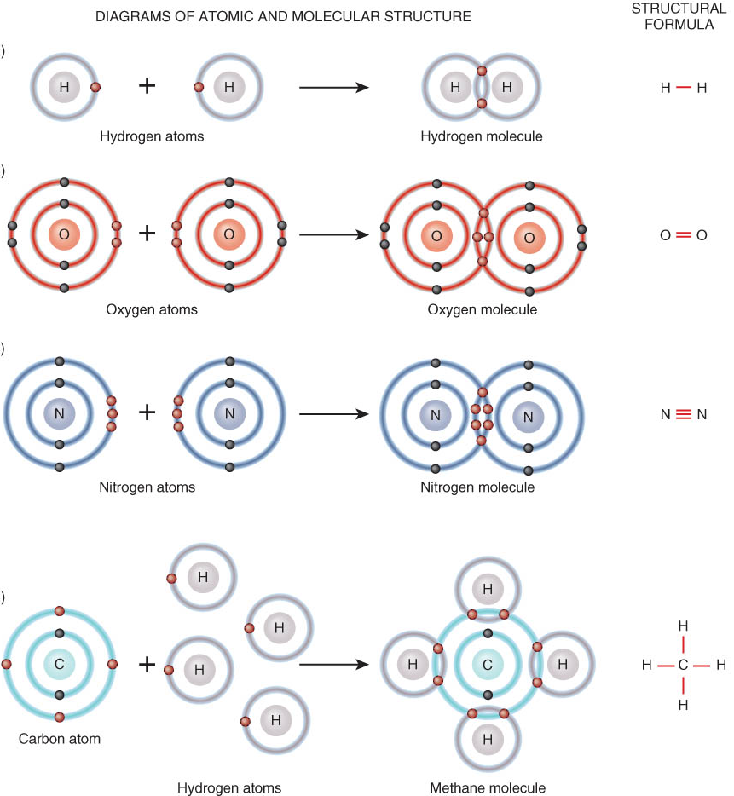
Covalent Bonds
Atoms share electrons to form covalent bonds
Non-polar covalent bonds share electrons equally
Polar covalent bonds share electrons unequally between the atoms involved

Slide 12
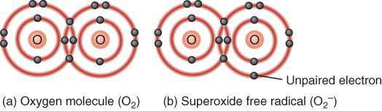
Have you ever wondered what a free radical is?
A free radical is an electrically charged atom or group of atoms with an unpaired electron in its outermost shell.
Unstable and highly reactive BUT can become stable by
  giving up an electron OR
  taking an electron from another molecule (example: breaking apart important body molecules)
Antioxidants are substances that inactivate oxygen-derived free radicals

Slide 13
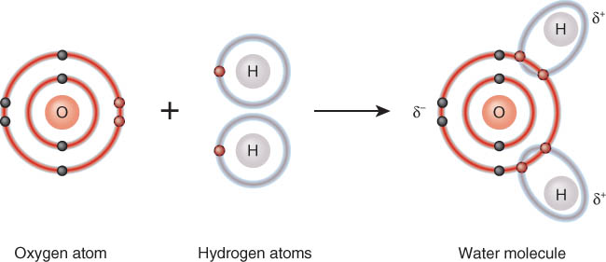
Classic Polar Covalent Bond
In a water molecule, oxygen attracts the hydrogen electrons more strongly
  Oxygen has greater electronegativity as indicated by the negative Greek delta sign.

Slide 14
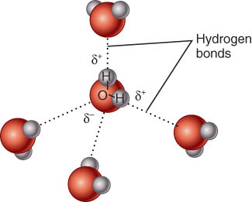
Hydrogen Bonds
Approximately 5% as strong as covalent bonds
Large 3-D molecules are often held together by a
large number of hydrogen bonds.
Water is the most important and abundant inorganic compound in all living systems.
An important property of water is its polarity.

Slide 15
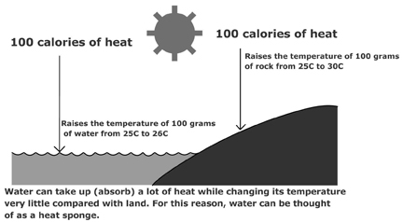
Properties of Water
Water has a high heat capacity.

Slide 16
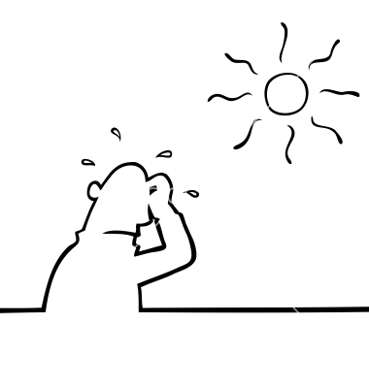
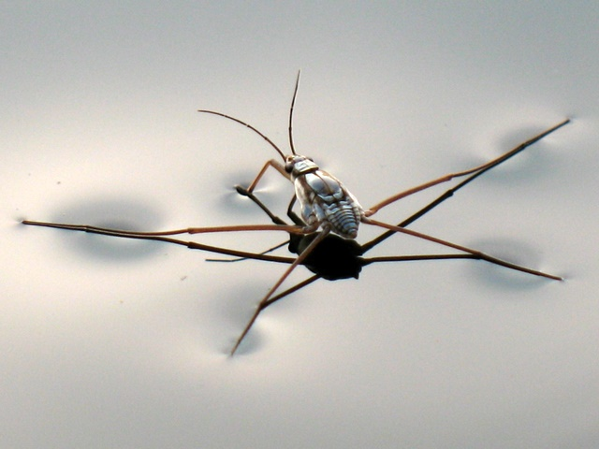
Properties of Water
Heat of vaporization is also high
  amount of heat needed to change from liquid to gas
Has high surface tension
  Can affect respiratory function

Slide 17
Properties of Water
Water is a major part of mucus and other lubricating fluids.
It is found wherever friction needs to be reduced or eliminated

Slide 18
Water in Chemical Reactions
Hydrolysis breaks large molecules down into simpler ones by adding a molecule of water.
Dehydration synthesis occurs when two simple molecules join together, eliminating a molecule of water in the process.

Slide 19
Water as a solvent
In a solution: the solvent dissolves the solute.
  Some examples
Substances that dissolve in water are hydrophilic, while substances that do not are hydrophobic.

Slide 20
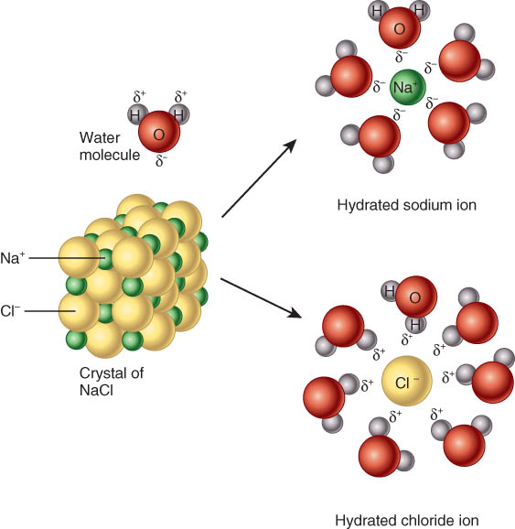
Water as a Solvent
Most versatile solvent known
  polar covalent bonds allow it to interact with many molecules
Water dissolves or suspends many substances

Slide 21

Check in Time…

Slide 22
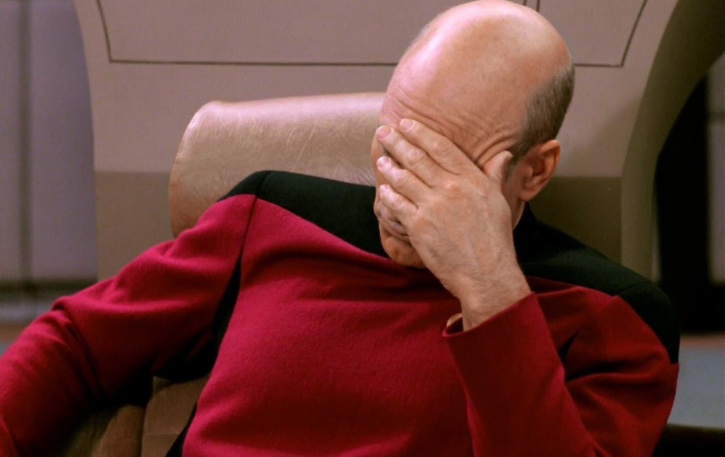
On to: pH

Slide 23
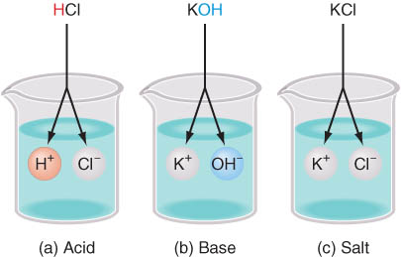
Acids and bases
  Electrolytes – substances that release ions in water
    Acids – electrolytes that release H (hydrogen) ions
    Bases – electrolytes that release ions that combine with H ions. Often dissociate into OH- (hydroxide ion)
    Salt – electrolytes that releases ions that are neither H or OH
  pH
    Concentration of H ions in solution
    Ranges from 0-14

Slide 24
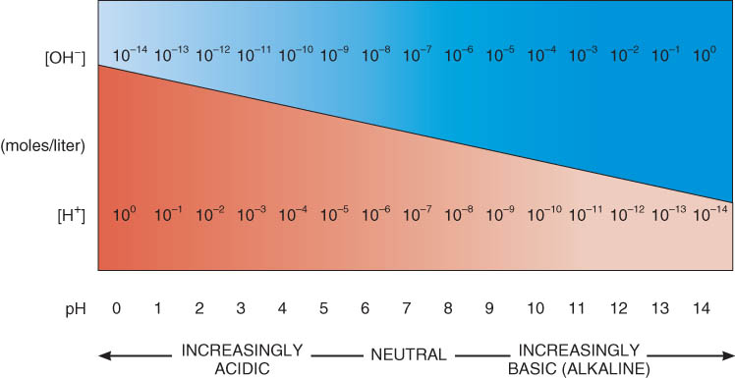
On to pH

Slide 25
Concept of pH
pH of 7 is neutral
  (distilled water -- concentration of OH- and H+ are equal)
pH below 7 is acidic ([H⁺] > [OH⁻]).
pH above 7 is alkaline ([H⁺] < [OH⁻]).
pH is a logarithmic scale
  Example: a change of two or three pH units
  pH of 1 contains 10x10=100 more H+ than pH of 3

Slide 26
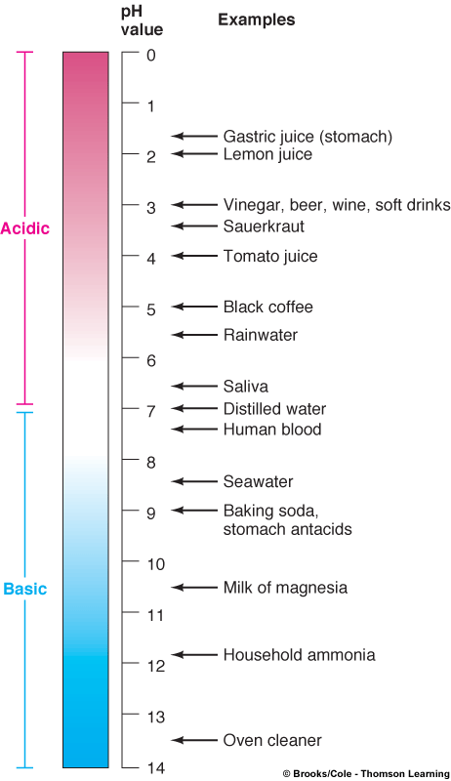
Biochemical reactions are very sensitive to even small changes in acidity or alkalinity.
  pH of blood is 7.35 to 7.45

Slide 27
Maintaining pH: Buffer Systems
The pH values of different parts of the body are maintained fairly constant by buffer systems
  Example: carbonic acid-bicarbonate buffer system.
CO₂ + H₂O ↔ H₂CO₃ ↔ H⁺ + HCO₃⁻

Slide 28
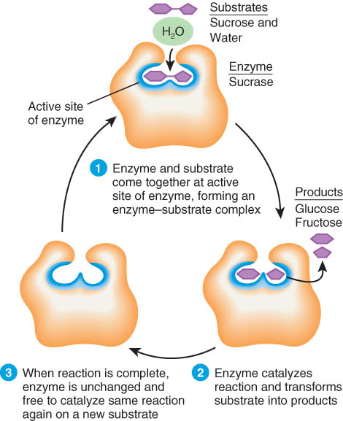
Chemical Reactions - Enzymes
Highly specific
Very efficient
  speed up reaction up to 10 billion times faster
Are unchanged after reaction occurs
Enzymes usually end in suffix -ase
  protease, and lipase are examples

Slide 29
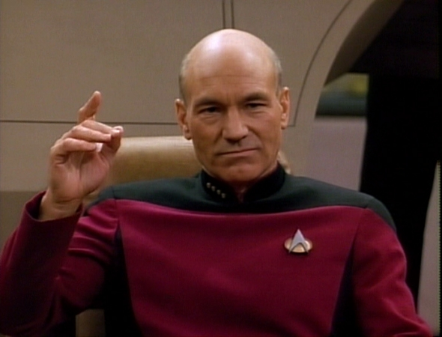
Any questions?

